Slide 1

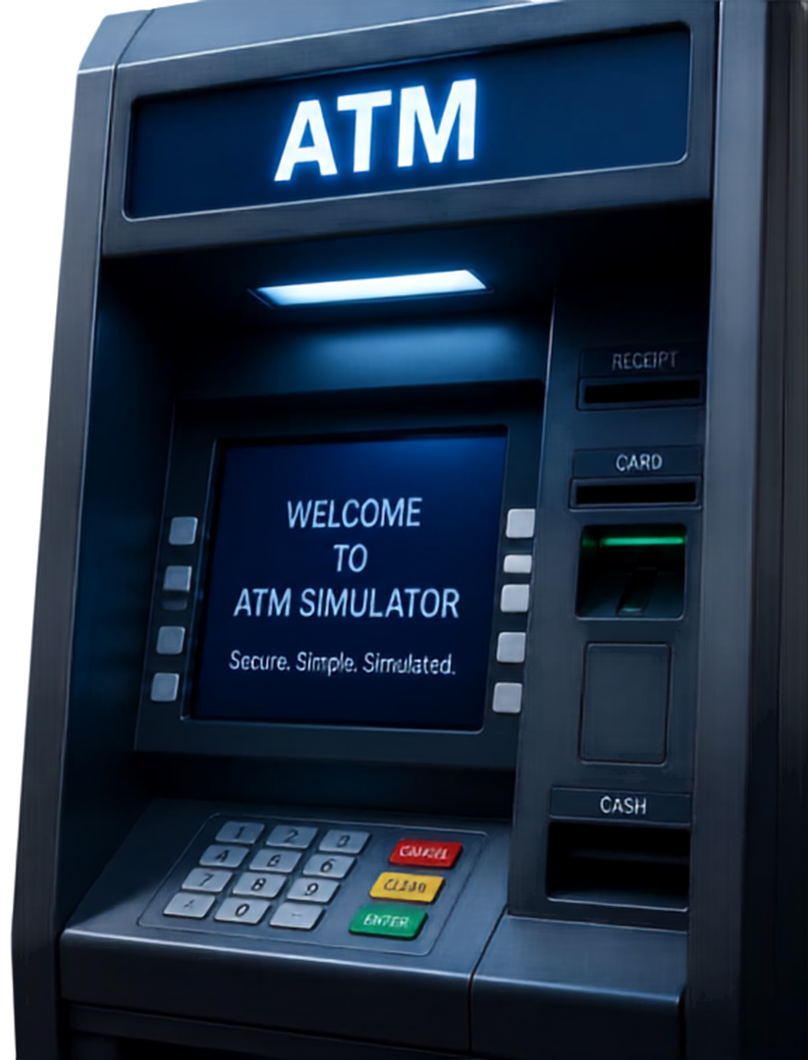
ATM SIMULATOR:
JAVA-BASED BANKING
WELCOME
TO
ATM SIMULATOR
PROJECT ID:
KLH/SPPJ/S11/11
PROJECT MEMBERS:
Secure. Simple. Simulated.
V Bhargav Krishna
D Harshith Varma
P Aditya
DATE:
September 15, 2026

Slide 2


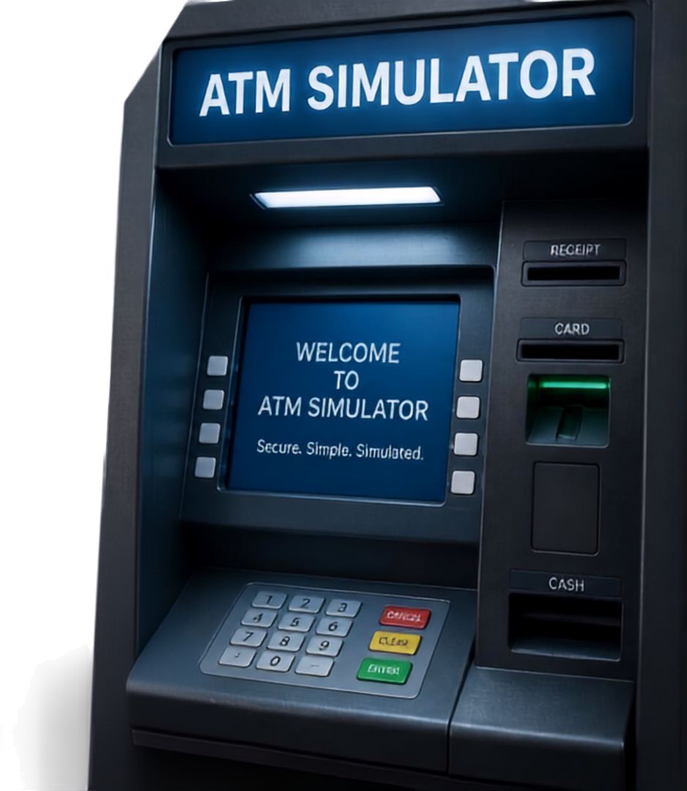
PROJECT
OVERVIEW
A Java-based ATM Simulator that replicates core banking operations in a secure environment
Includes authentication, balance check, deposits, withdrawals, transaction history, and exit
Built to demonstrate key programming concepts through practical application
Provides a safe, realistic way to learn and practice banking workflows without real accounts

Slide 3

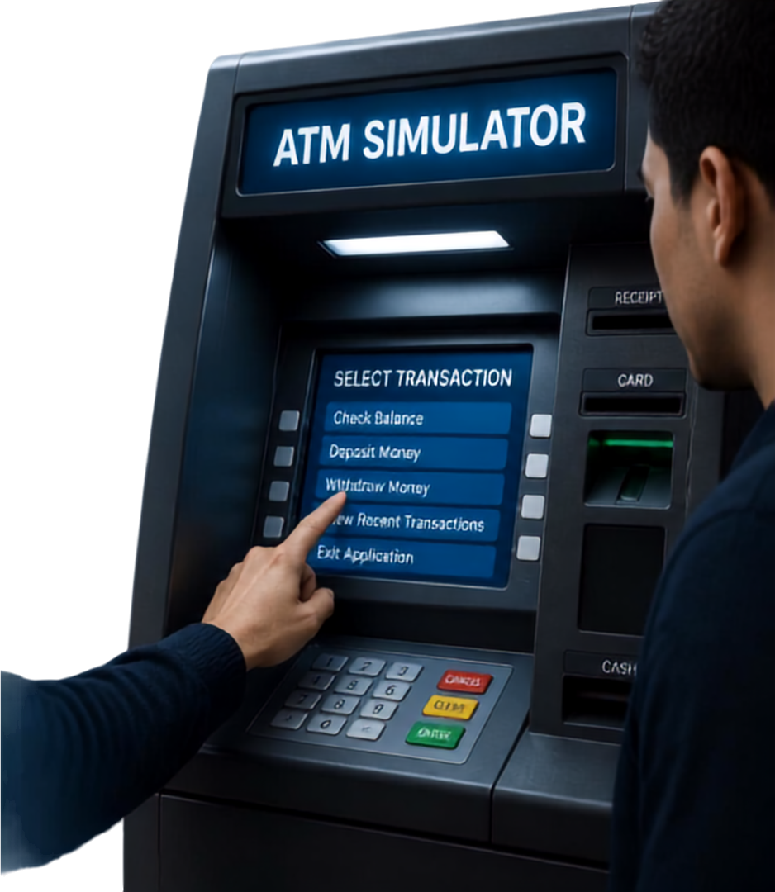




AUTHENTICATION AND TRANSACTION MENU
01
Secure login with account number and PIN
02
Access core transactions:
balance, deposit, withdraw, recent transactions
03
Built-in validation to ensure accurate and authorized actions
04
Exit cleanly and securely

Slide 4

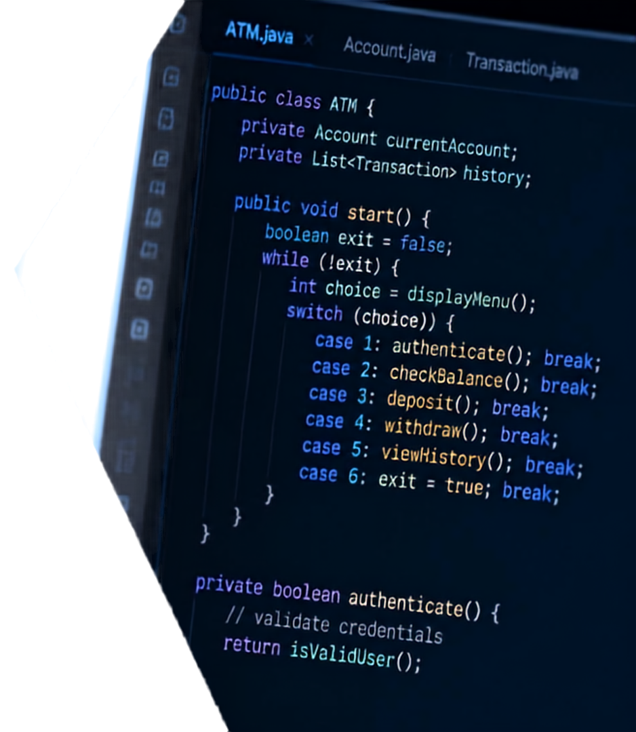

CORE PROGRAMMING
CONCEPTS
DEMONSTRATED
Object-oriented design models real-world entities
Conditional logic controls access and transactions
Loops keep the menu running until exit
Input validation ensures secure, accurate entries
Data management updates balances and history

Slide 5




BENEFITS AND PRACTICAL APPLICATIONS
SIMULATED EXPERIENCE
VS
REAL EXPERIENCE
Safe practice of ATM operations without any risk
Risk of financial errors and data exposure
Understand the programming logic and banking workflows
Limited visibility into backend processes
Easily extend with new features like multi-account support or persistent storage
Changes require access to live systems
Ideal tool for learning
Java application development
Higher cost and complexity for testing and learning

Slide 6

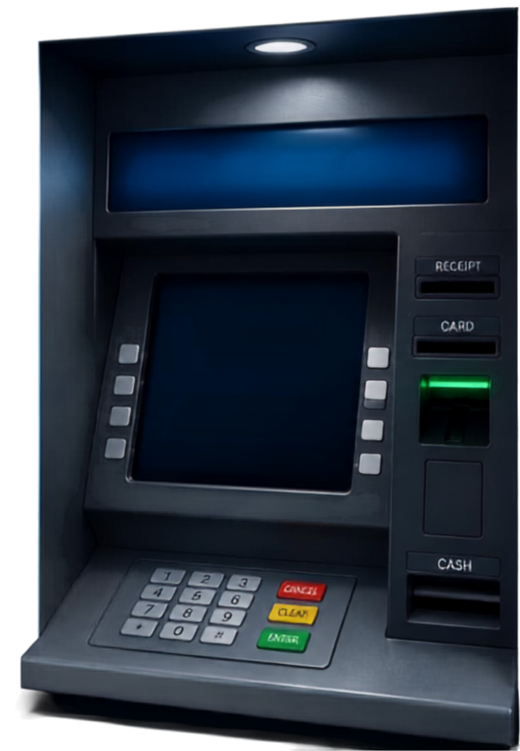
THANK YOU
ATM SIMULATOR
AND QUESTIONS
THANK YOU
for your time
thank you for your attention
questions and discussion welcome
QUESTIONS AND DISCUSSION WELCOME
we appreciate your engagement
let's continue the conversation

